Slide 1
HW: Latent Semantic Analysis (LSA)
Col.
# Doc
Row
#Tem
Nonzero entries
Given a sparse term-document matrix
  E.g., 4 terms and 3 docs
  Each entry can be weighted by TFxIDF score
Perform SVD to obtain term and document vectors represented in the latent semantic space
Evaluate the information retrieval capability of the LSA approach by using varying sizes (e.g., 100, 200, ..,600 etc.) of LSA dimensionality
4 3 6
2
0 2.3
2 3.8
1
1 1.3
3
0 4.2
1 2.2
2 0.5
2 nonzero entries at Col 0
Doc
Col 0, Row 0
2.3 0.0 4.2
0.0 1.3 2.2
3.8 0.0 0.5
0.0 0.0 0.0
Col 0, Row 2
1 nonzero entry
at Col 1
Term
Col 1, Row 1
3 nonzero entry
at Col 2
Col 2, Row 0
Col 2, Row 1
Col 2, Row 2
IR 2004 – Berlin Chen <number>

Slide 2
HW: Latent Semantic Analysis (cont.)
Example: term-document matrix
SVD command (IR_svd.bat)
svd -r st -o LSA100 -d 100 Term-Doc-Matrix
Indexing Term no.
Doc no.
Nonzero entries
51253 2265 218852
77
508 7.725771
596 16.213399
612 13.080868
709 7.725771
713 7.725771
744 7.725771
1190 7.725771
1200 16.213399
1259 7.725771
……
output
LSA100-Ut
LSA100-S
LSA100-Vt
sparse matrix input
prefix of output files
No. of reserved eigenvectors
name of sparse matrix input
IR 2004 – Berlin Chen <number>

Slide 3
HW: Latent Semantic Analysis (cont.)
LSA100-Ut
LSA100-S
51253 words
100 51253
0.003 0.001 ……..
0.002 0.002 …….
word vector (u^{T}): 1x100
LSA100-Vt
2265 docs
100 2265
0.021 0.035 ……..
0.012 0.022 …….
100
2686.18
829.941
559.59
….
100 eigenvalues
doc vector (v^{T}): 1x100
IR 2004 – Berlin Chen <number>

Slide 4
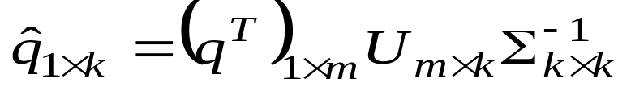
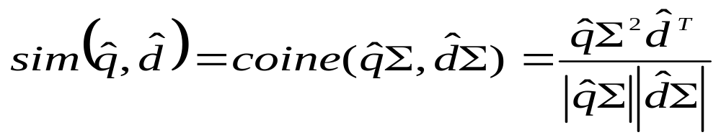
HW: Latent Semantic Analysis (cont.)
Fold-in a new mx1 query vector
Cosine measure between the query and doc vectors in the latent semantic space
The separate dimensions
are differentially weighted
Just like a row of V
Query represented by the weighted
sum of it constituent term vectors
TFxIDF weighted beforehand
IR 2004 – Berlin Chen <number>

